Slide 1





GCSE Options Assembly
Mrs Bassi - Assistant Principal KS4
Miss Harvey - Head of Year 9
Tuesday 11th February 2025

Slide 2



Slide 3
What are options?
Year 9 options are the decisions your child will make as to which subjects they wish to continue studying and which subjects they will drop!
This process is the first step toward your child’s future destination(s)
It is VITAL that they think carefully about the choices they make and the subjects they chose.
The decisions they make can impact on your future choices.
They may or may not have an idea about future careers. Please do not feel under pressure, this is entirely common.
These “option” subjects shape the immediate direction, but they do not mean other options will not be available beyond Year 11
“The doors we open and close each day decide the lives we live.”

Slide 4
Year 9 Options – General Overview
You will follow a ‘Core Curriculum’ of subjects that all students will take.
You will have a further choice of 20 subjects you can choose from.
You will also be advised of a specific pathway that will be most appropriate for you.

Slide 5
Choose a course because….
It’s suitable for your skills and ability
It suits your interests
You are good at it and you will continue to do well in it.
It links to future career pathways
You think you might want to pick it for Post 16
It goes well with other choices

Slide 6
Do not choose a course because…
Your friends have choose the subject
You think it will be easy
Someone else thinks its a good idea for you to do it
You like the teacher you have now
Options are your choice! Make the right decision for your based on what you have discovered and discussed about your hopes, goals, dreams and career aspirations.

Slide 7

Timeline and Procedures:
Options Information sessions- w/c 10th February 2025 Options Evening – 11th February 2025 Options Booklet Release – 11th February 2025 Options Form Deadline – Tuesday 25th February 2025 Guidance meetings – March 2025 Confirmation of Triple Science – April 2025 (after AP2) Confirmation of Options – July 2025 Waiting list open – July 2025 Options Closes – 19th September 2025
Throughout the process further support and guidance will be provided to you.
This will also allow you to ask the questions you may need answering as you get more and more information……..

Slide 8
Guidance Meetings
Take place once Option Forms have been collected and collated
Purpose: to go through option choices with the student and support in final confirmation of options
Starting in March and continuing into May
In the past we have found that, not all students require these meetings. It is usually in situations where students have: a particularly academic pathway, an untraditional pathway or any other markers that suggest the student has made decisions which may adversely affect their outcomes
Historically, the majority of students have not required these meetings and have been comfortable and confident in their choices

Slide 9

BUT please don’t…
STRESS OR PANIC
Think
Plan
Research
Discuss

Slide 10
Core Curriculum
Compulsory Subject | Number of subjects | Lessons WK A & B | Board
English Language and Literature | 2 | 9 | AQA
Mathematics | 1 | 9 | Edexcel or OCR
Science Combined and Trilogy | Combined 2 Trilogy 3 | 7 | AQA
PSHE |  | 2 | Not examined
PE |  | 2 | Not examined

Slide 11
“Triple” (Separate) Science & Computer Science
Triple Science and Computer Science remain non-option subjects and is based on prior attainment and academic performance
This means we select those students who are eligible to pick Triple science and Computer Science
This is done to ensure the suitability of students to the course
Data from assessments will be factored in to the selection of students
Students should pick their options as normal

Slide 12
History & Geography
► To ensure suitability, any students wishing to study both History and Geography must make contact with the school indicating this is their preference
► Purpose: the exam demand in studying both subjects is challenging and the balance of this with other options must be considered and a conversation between the school and student needs to take place before approval

Slide 13
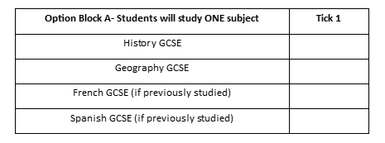
French or Spanish
Students must select from French or Spanish, but it must be a language they studied in KS3.
From Option Block A students must select one subject from History, Geography, French or Spanish

Slide 14
Things to consider
Most Post 16 providers that offer A Levels and BTEC Level 3 course will require at minimum 5 GCSEs grade 5 and above.
Some more complex subjects may have higher GCSE expectations such as Psychology or Maths may require you to have a grade 6 or above at GCSE in English Language and Maths
Keep your choices open and do your research!!

Slide 15
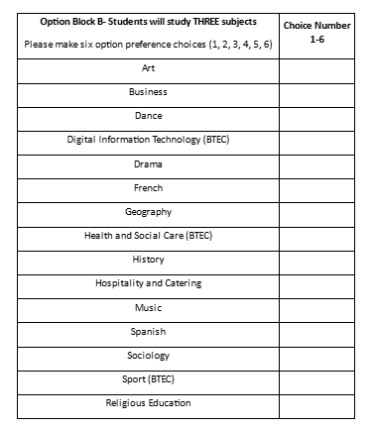
Options

Slide 16
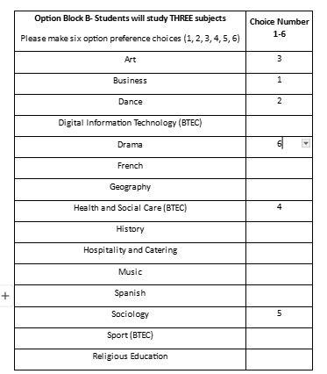
What you need to do:

Slide 17


What do you need to do now?
QR Code - will take you to the course specification, so you can have a look at the course and what will be taught over the 2 years.

