Slide 1






Work Experience
Year 10: Monday 22nd June 2026 – Friday 26th June 2026
Year 12: Monday 13th July 2026 – Friday 17th July 2026

Slide 2
Aims for this evening:
- To provide you with a timeline of how work experience will work in Year 10 and Year 12.
- To understand the purpose and benefits of students completing work experience.
- To provide examples of how the process and logistics of work experience will work.

Slide 3
Date | Activity
September October 2025 | Work experience launch for Year 10 and Year 12
October 2025 November 2025 | Work experience information evening for parents
December 2025 | Year 10 placement form deadline: Friday 12th December 2025
January 2026 | Year 12 placement form deadline: Friday 30th January 2026
February 2026 | Careers drop down day and careers fair
February – May 2026 | Level 6 Careers advisor to carry out H&S checks as well as provide final placement confirmation form
February – May 2026 | Students required to contact placement Students encouraged to visit placement
June 2026 | Final preparation session
June 2026 | Year 10 placement to take place with visit from member of staff Placement booklet to be completed
July 2026 | Year 10 placement to take place with visit from member of staff Placement booklet to be completed
July 2026 | Review and evaluation of work experience

Slide 4
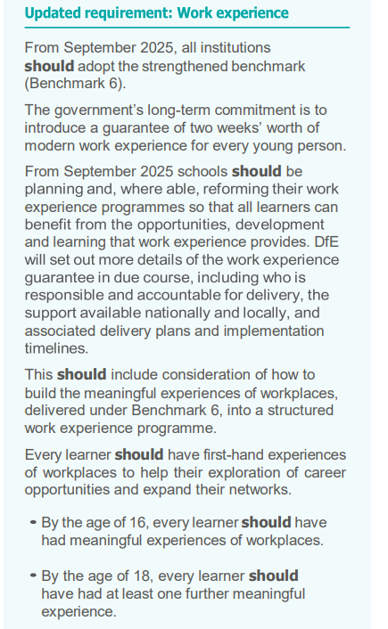

Slide 5
Benefits of Work Experience
  Helps students explore job roles and industries.
  Supports them in making informed decisions about future careers or studies.
Skill Development
  Builds communication, teamwork, and time management.
  Teaches workplace behaviour and basic job skills.
Confidence Boost
  Encourages independence and self-belief.
  Helps students feel more comfortable in adult environments.
Improves Employability
  Strengthens CVs and job/college applications.
  Provides references and real-life examples for interviews.
Academic Motivation
  Shows the real-world value of school subjects.
  Inspires clearer goals and greater focus in class.
Networking
  Offers early connections with professionals.
  May lead to future opportunities or guidance.
Real-World Perspective
  Teaches the realities of working life.
  Builds appreciation for effort, time, and money.

Slide 6
What do we need from you as parents/carers?
- Support child in finding a placement
- Support child in contacting a placement but not to do it on behalf of them
- Ensuring child fills in the placement form correctly and hands in to Reception
Ensuring child contacts/visits the placement prior to the work experience week
- Ensuring child has worked out transport and uniform

Slide 7
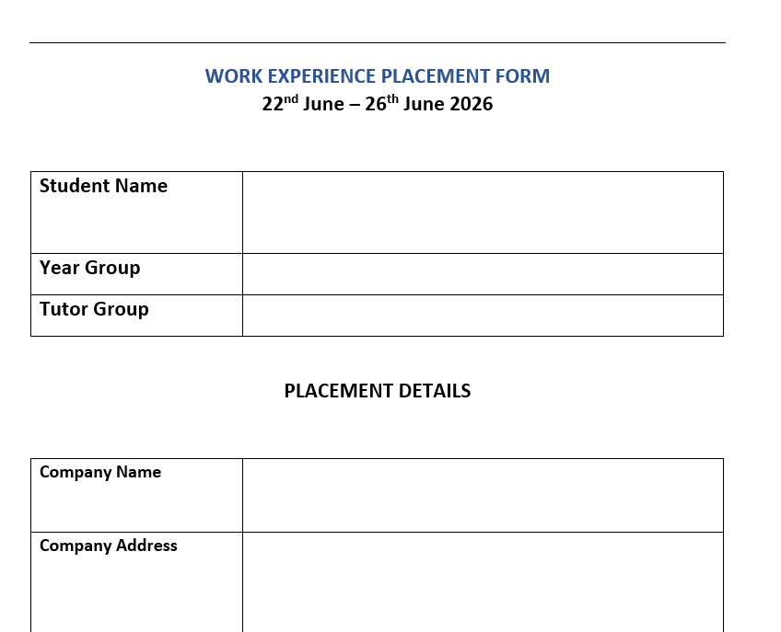

Slide 8
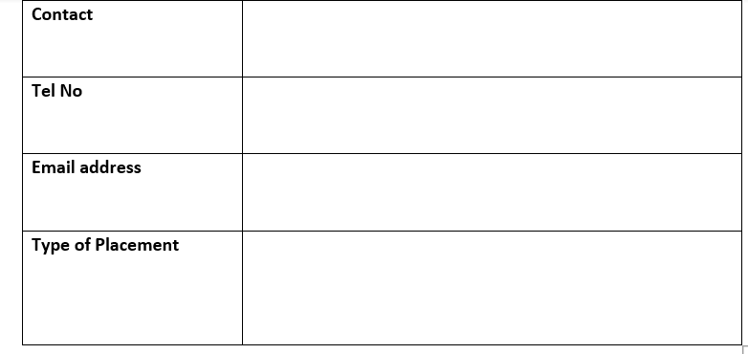
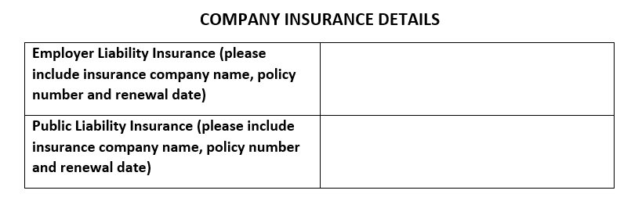

Slide 9


Slide 10
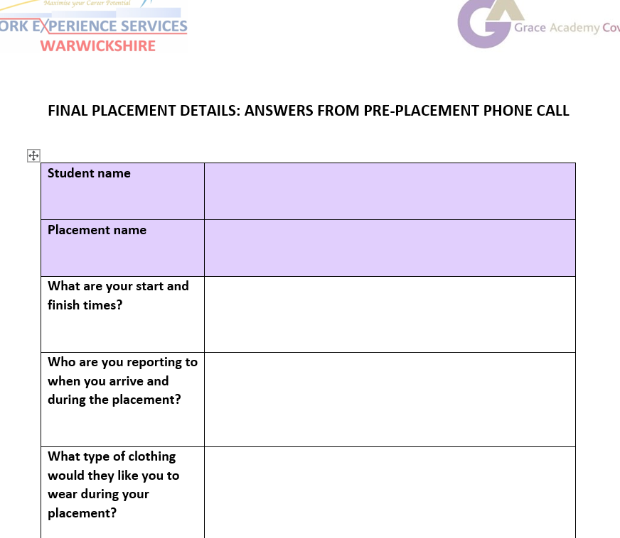
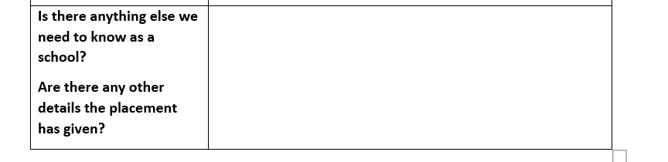

Slide 11
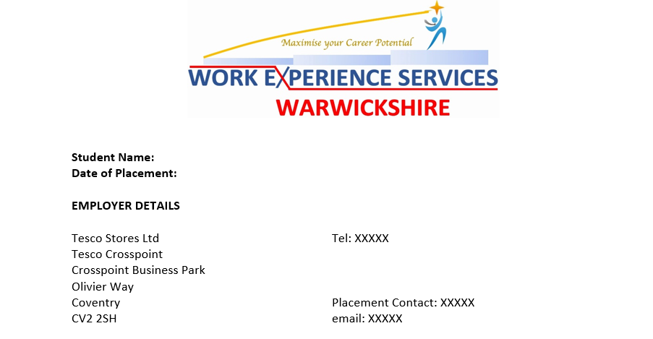
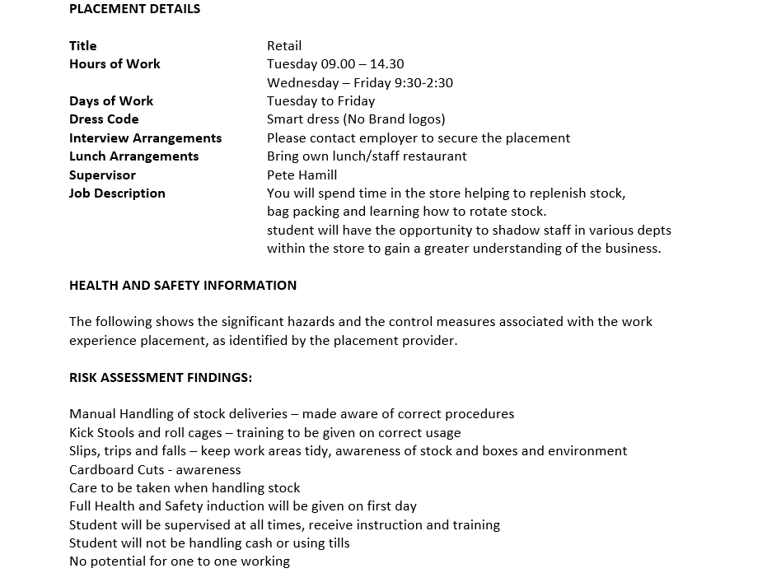

Slide 12
Can you help?
Career talks
Support with subject specific focus
Attend school career events – fairs and apprenticeships
Visits
Work experience placements

Slide 13
All slides shared this evening will be on the schools website in the next 7 days.
Students should start to enquire and research possible ideas for a placement, to hand in their placement form for the deadline given.
If you are able to support, or have any relatives or friends that may be able to support with the school’s careers provision, or have any questions then please contact us:
Assistant Principal: Mrs E Williams
emilywilliams@graceacademy.org.uk
Careers Co-Ordinator: Miss S Ellam
samanthaellam@graceacademy.org.uk
Head of Year 10: Miss E Harvey
ellieharvey@graceacademy.org.uk
Assistant Principal for Post 16: Mr R Mann
rapindermann@graceacademy.org.uk
Head of Post 16: Mrs L Moore
louisemoore@graceacademy.org.uk

